Slide 1
Energy active composites for energy storage Systems (ESS)
ALTECHLAB of IT Network R&D Project
www.altechlaboratory.com

Slide 2
ALTECHLAB R&D Project www.altechlaboratory.com
EAC CONCEPT:
Energy Active Composites (EAC) is a new type of CF (Carbon Fiber) materials for Energy Storage Systems by non-standard charging process.
EAC it’s solid but flexible silicon-graphene energy active materials which is can rapidly change its surface electrical status by special low power signals.
EAC respond to different charging signals and are very good materials to create a new type of Turbo Fast charging Energy Storage by different applications.
EAC technology can open absolutely new possibilities for mass production of build-in (in situ) batteries, printed electronics, Energy storage, EV and different devices by Mobile/Military/Space applications.
EAC - elements for a new era of energy abundance—natural resources, technology, capital, and an entrepreneurial spirit.

Slide 3
ALTECHLAB R&D Project www.altechlaboratory.com
RESULT OF OUR R&D ACTIVITIES:
In last 3 years by our International team and small lab in Walled Lake, Michigan we have some interested phenomena results such as high energy density in Silicon, Carbone and metallic composites.
We use that in DC/AC inverter and direct 12V loads such as LED and micro motors and we observed a long run effect!
Even we try to replace expensive and danger Lithium materials in our new type of batteries for Energy Storage by Magnesium and other metallic composites.
That became our main idea in new project-Energy Active Composites for Energy Storage Technology by built-in powered circuits and flexible printed electronics.
This kind of Energy Modules can be energy independed, long run, very practical devices by many applications.

Slide 4
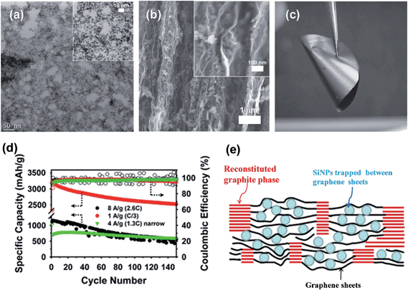
ALTECHLAB of IT Network www.altechlaboratory.com
We obtain a voltage about 1.5V-2,45V without any charge of carbon materials-silicate-magnesium “sandwich” but we still working at more energy density models and faster charge process. We try to use graphite and silicon composites in our passive (without any charge) and active (charge with special low energy signals) models.

Slide 5
ALTECHLAB R&D Project www.altechlaboratory.com
EAC in Silicon - Carbone batteries
Lithium batteries and composites
Low cost and very available earth row materials
Low cost in mass production what make the energy storage and finished products not expensive and popular on a market
Secure, flexible (banded) and NON damageable and NON flammable batteries.
Fast charge by standard and non-standard circuits
High in cost in just 2 earth sources for Lithium
Classical limited charging process for Li-batteries and dangerous overcharge accidents
Long time for charging process under standard 1C or 2C circuits
Flammable, explosive dangerous materials and batteries

Slide 6
ALTECHLAB R&D project expenses and prospective plans:
As a next step in our project we have to create test production in Oakland county (April 2017), upgrade our Lab and business operation facility. In this object we are looking for Investors and Partners.
First stage of our project development it’s IP certificate(Intellectual property certificate-patent or pending patent), proof of concept working models, official test protocols and rapports. Technology card for mass production – I’s a second stage of the project. Total cost for Lab and new facility with test production, existing business activities and income can be around $ 1,5mil in 2017 and about $ 5mil for 2020.
We expect to get a patent and production license for EAC in 2017-2018. As a second scenario of our project development we have a plan to create a production company in Michigan and branches around the world.
For more details you can contact us directly and talk about project details by strategy partner - Mike Diaz: (248)613-1559 mikehdiaz@gmail.com

